Slide 1

Title of the Presentation
Theme & Project Number

Slide 2





BLADLESS WINDPOWER GENERATION
VENKUMAHANTHI TANIYA
PATNAM VENKATA SAI AMUKTHA
Dr. Shanmukha Nagaraj
Dean Academics
Mechanical
R SHRADHA
KRIT PALIWAL

Slide 3
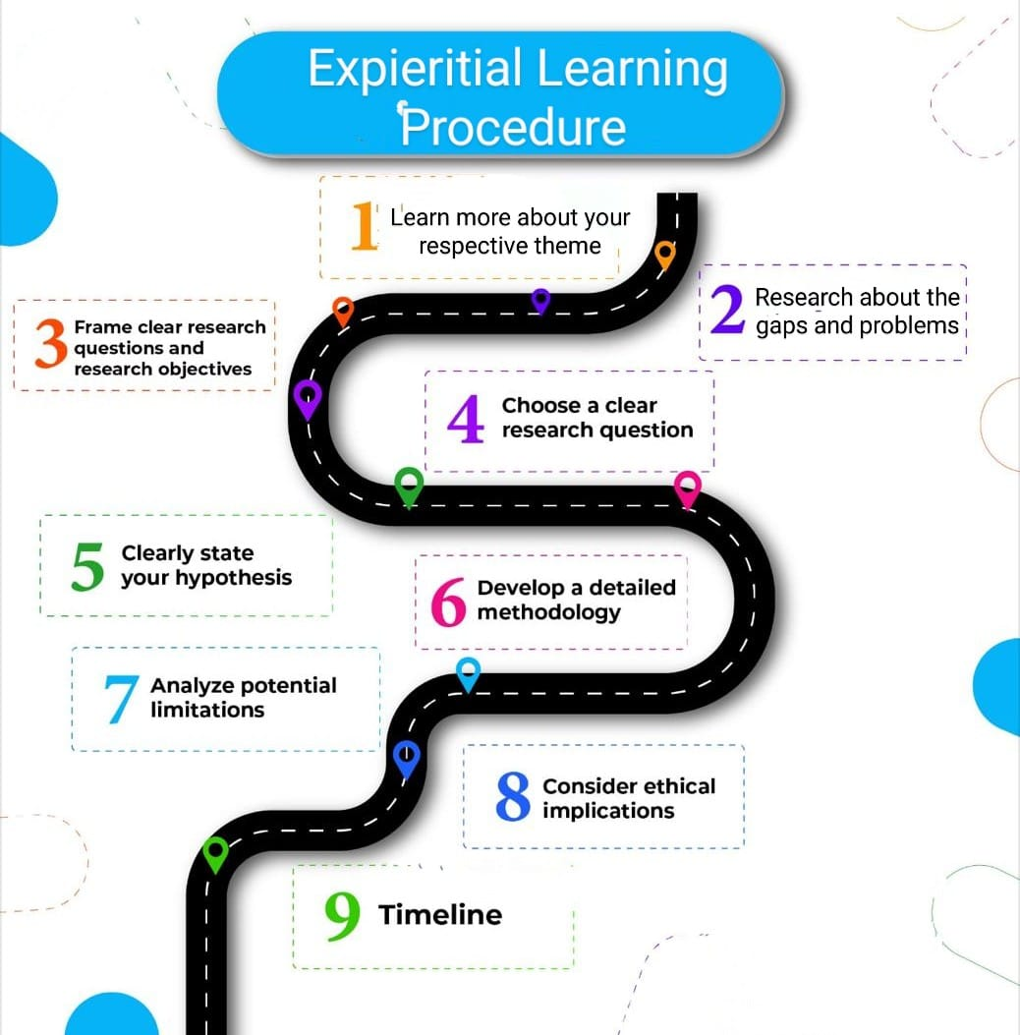

Slide 4
EL Phase-I
Presentation Outline
Introduction
Literature Review
Problem Definition
Objectives
Methodology
Proposed Outcomes
Timeline of the project
Conclusion
References

Slide 5
Introduction
Overview of the topic: Briefly introduce your topic; explain what it is about and why it matters.
Importance of the topic: Use statistics or anecdotes to make it relatable. Give proper justification about the topic and why it should be discussed

Slide 6
Literature Review
Key studies and Findings: Summarize 4 to 5 significant studies (journals) related to your topic. Read through the publications’ abstracts and summarize the contributions in the paper.
Trends in Literature: Highlight current trends in that particular domain by referring to different papers
Theoretical Framework: Briefly define your theoretical framework and its relevance to your topic.
Relevance to current research: Explain how these studies relate to your project and support your project problem.

Slide 7
Problem Definition
Clear statement of the problem: Define the problem you are addressing with clarity.
Context of the Problem: Provide background information that helps to understand the significance of the problem.
Significance of Addressing the Problem: Explain the potential consequences of not addressing this issue. Identify the gaps that would happen if the problem is not addressed.

Slide 8
Objectives
Main Objective: State the primary goal of your project in one clear sentence.
Specific Objectives: List 2-4 specific objectives that guide your project.
Expected Contributions to the Field: Highlight what you hope to achieve and how it adds value to existing knowledge.

Slide 9
Methodology
Design: Describe your approach (qualitative, quantitative, or mixed methods).
Data Collection Methods: Explain how you will gather data (surveys, interviews, experiments).
Data Analysis Techniques: Specify how you will analyze the data (statistical analysis, thematic analysis).
Tools and Resources Used: Mention any software or tools you plan to use in your project.

Slide 10
Methodology
Use a flowchart to depict your research process.

Slide 11
Proposed Outcomes
Expected Results: What do you anticipate as a solution to the problem in your project? Share your expected outcomes.
Potential Impact on the Field: Discuss how your findings could influence practical implementation or future work.
Future Research Directions: Suggest how your project might open doors for additional studies.

Slide 12
Timeline of the project
Project Timeline Overview
Initiation Phase (Weeks 1-2)
  Define project goals and objectives.
  Identify group members and resources.
  Conduct feasibility studies.
Planning Phase (Weeks 3-4)
  Develop a detailed project plan, including tasks and timelines.
  Allocate resources and assign responsibilities.
  Create a budget plan.
Execution Phase (Weeks 5-10)
  Begin project work according to the project plan.
  Hold regular team meetings to monitor progress.
  Implement communication strategies with group members.
Closure Phase (Weeks 11-13)
  Complete final deliverables and obtain panel approval.
  Present in project review and document lessons learned.
  Formally close the project.

Slide 13
Conclusion
Summary of Key Points: Recap the most important aspects of your presentation succinctly.
Final Thoughts: Share a concluding statement.
Call to Action or Next Steps: Further road map or implications of your work.

Slide 14
References
List of References: Provide a formatted list of all sources cited in your presentation. ( Journals, conference publications, books, patents etc)
Citations in Appropriate Format: Use APA citation style.

Slide 15
Expected Outcome by the end of First Year
EL should aim for tangible results in one of the following forms:
Patent Filing: If your prototype shows novel functionality or an innovative process, file for a patent. Steps include drafting a patent description, claims, and conducting a prior art search.
Journal Publication: Write a comprehensive paper detailing the methodology, prototype design, testing, and results. Submit to journals related to manufacturing technology, engineering design, or industrial innovation.(scopus indexed journals)
Conference Publication: Prepare an abstract or full paper for submission to conferences. Present your prototype development, key findings, and future research possibilities (Paper to be drafted as per IEEE format. Format will be shared later on)
Research Proposal: Propose extending the research into a larger project, securing funding for mass production, or applying the process to different industries. Include objectives, proposed methodology, expected impacts, and a budget estimate.

Slide 16


